Slide 1
Target Demographic
By Darren Wright

Slide 2
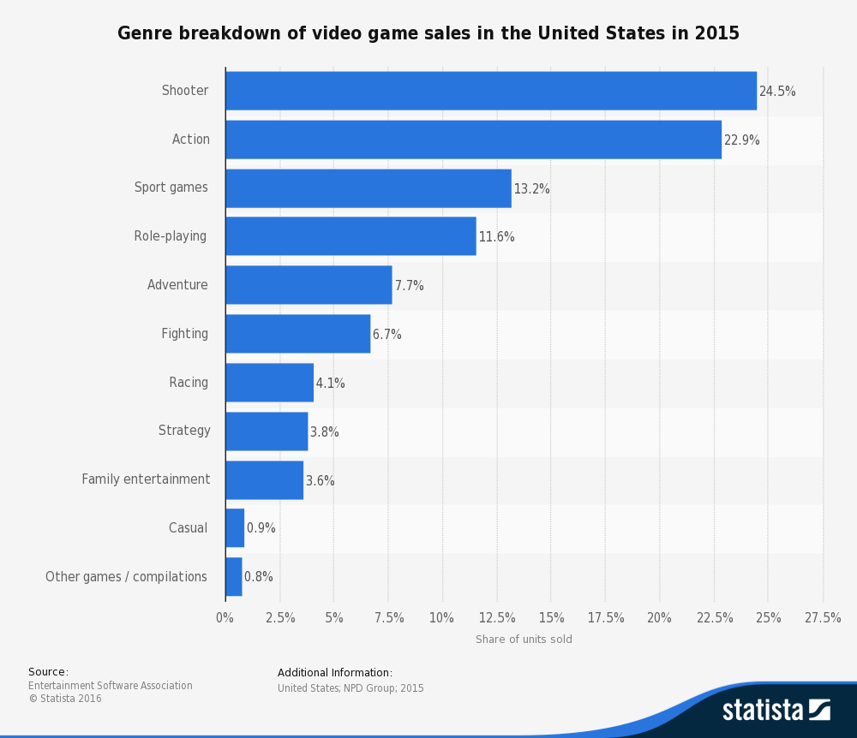
Gamers and the genres they play (In The United States)
Image to the right shows game sales by genre in the United States. From this we can see that the shooter genre is the favoured genre of choice at 24.5% followed closely by the action genre at 22.9%.

Slide 3
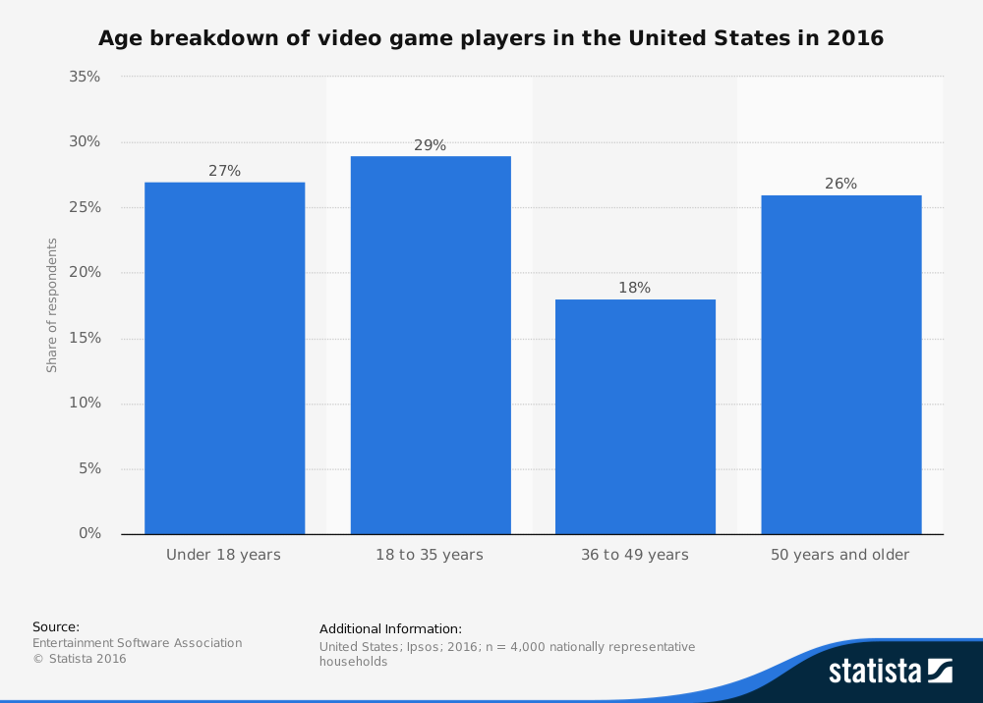
Gamers by age (IN THE UNITED STATES)
According to the Entertainment Software Association, in the US the ages between 18 and 35 years old is the age group that plays more games than any other, there's a drop off between 36 to 49 however the range of gamers increases again above the age of 50.

Slide 4
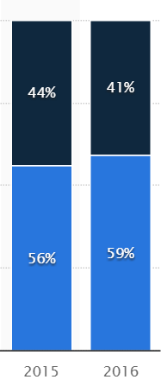
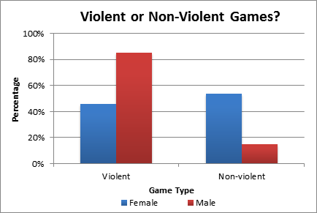

Gamers by gender

Slide 5
Gamers by gender (continued)
In the US in 2016 the majority of gamers are male with a 59% section of the market.
In 2012 usabilitynews.org researched in to which percentage of men and women played violent video games. The results showed that a higher percentage of men preferred to play video games that featured violence and that women preferred video games that did not feature violence.

Slide 6
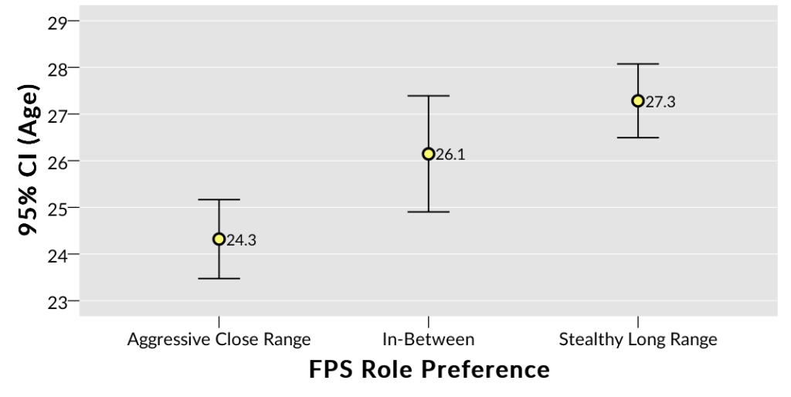
What playstyle do people prefer?
In an article and survey by Kaleb Embaugh of Quantic Foundry he discovered that the gamers aged 23 to 25 preferred a more run and gun style of gameplay to those of the 26 to 28 aged range who much preferred the use of stealth.

Slide 7
Sources Used
Statista. 2016. U.S. most popular video game genres 2015 | Statista. [ONLINE] Available at: https://www.statista.com/statistics/189592/breakdown-of-us-video-game-sales-2009-by-genre/.
M. H. Phan, J. R. Jardina, & W. S. Hoyle. 2012. Video Games: Males Prefer Violence while Females Prefer Social. [ONLINE] Available at: http://usabilitynews.org/video-games-males-prefer-violence-while-females-prefer-social/.
Quantic Foundry. 2016. In FPS Games, Women Prefer Long-Range Stealth, Younger Gamers Prefer Run-and-Gun - Quantic Foundry. [ONLINE] Available at: http://quanticfoundry.com/2016/02/02/fps-roles/.

